Slide 1

Common Chart Types and Use Cases, Part 1
Histograms & Pareto Charts
Bar & Column Charts
Line Charts
Area Charts

Slide 2
The Practice Excel File
In this section, open the “Excel-Part 2.xlsx” file and generate plots for each sheet.

Slide 3
Histograms & Pareto Charts
Used for: Showing the distribution of a continuous dataset.
Examples:
Frequency of test scores
Distribution of population by age
Pro Tips:
Adjust bin size to control grouping.
Use Pareto Charts to visualize cumulative impact.

Slide 4
Practice: Test Scores, Hours Studied, and Sleep Hours Distributions
Sheet name on the Excel file: Histogram & Pareto Charts
Start by selecting the column of interest
Go to the Insert tab and select Histogram.
The graph will be populated automatically.
Adjust the chart title and the axis tick size as needed.

Slide 5
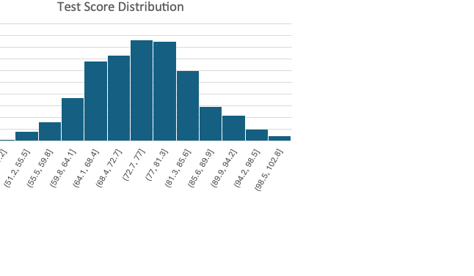
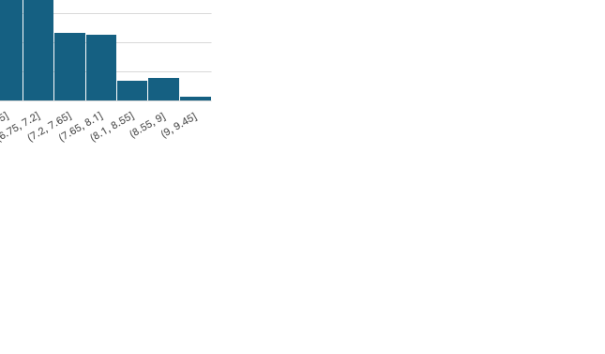
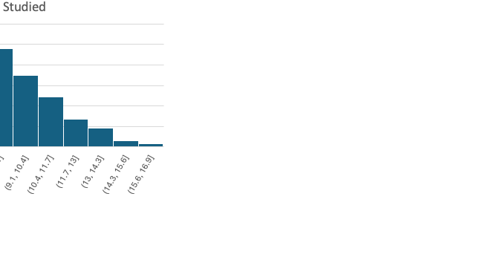
These graphs show the distributions of test score, hours studied, and sleep hours per one full day for a group of students

Slide 6
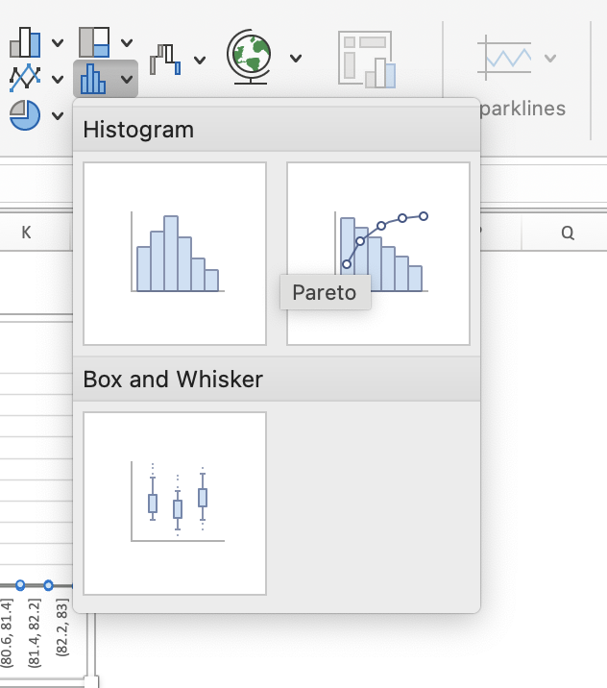
Pro Tips: Use Pareto Charts to visualize cumulative impact.
You can also choose a Pareto Charts under the same option as described previously for Histogram chart.
Pareto Charts also shows the cumulative impact of each factor

Slide 7
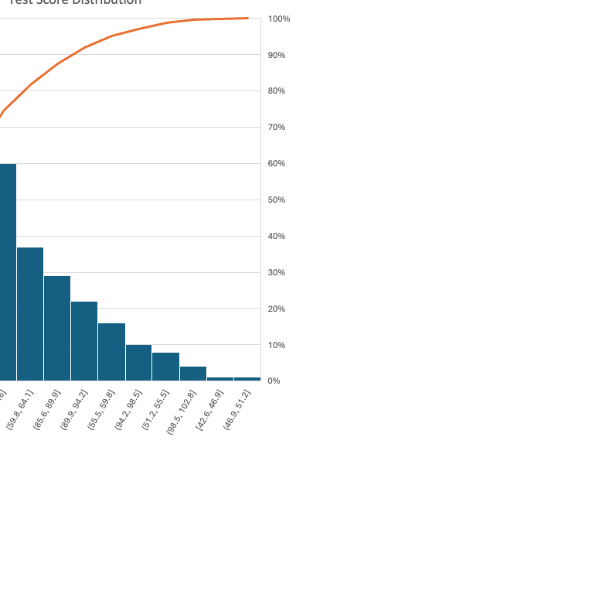
Practice: Pareto Charts

Slide 8
Customizing Charts in Excel – The Chart Design Tab
Before we start building charts, it's important to learn how to customize and style them using Excel’s Chart Design tab — this will apply to all the charts we create later.

Slide 9
📌 Key Features in the Chart Design Tab:
🎨 Change Colors
Pick color palettes that fit your theme or brand.
Helps create visual contrast between data series.
🖼️ Chart Styles
Use pre-designed styles for a professional look.
Options include 2D/3D effects, shadows, gradients, etc.
🔄 Switch Row/Column
Flip how data is plotted—great for stacked charts or when Excel guesses wrong.
🔁 Change Chart Type
Convert your chart to another type anytime (e.g., Bar → Line → Combo).
Ideal for exploring the best visualization method for your data.
📈 Select Data
Modify the data range, add/remove series, or edit labels.
🧩 Quick Layouts
Pre-made chart layouts that adjust placement of titles, labels, legends, and more.
Saves time and ensures consistency across charts.

Slide 10
📌 Add Chart Elements
Click "Add Chart Element" to include or customize:
📋 Chart Title – Add a meaningful title directly on your chart.
🏷️ Axis Titles – Label x- and y-axes for clarity.
📍 Data Labels – Show values on each bar, line, or point.
📊 Legend – Helps identify what each color or line represents.
📏 Gridlines – Add/remove horizontal and vertical guides.
📉 Trendlines – Show patterns or forecast future data points.

Slide 11
🧩 Quick Layouts – One Click, Many Changes:
Instantly apply a preset layout to structure your chart elements.
Each layout rearranges key items (title, legend, labels) in a clean way.
Great starting point if you're unsure how to organize your chart.

Slide 12
💡 Tips for Effective Design:
Always include clear axis titles and a descriptive chart title.
Use data labels sparingly—only where they add value.
Keep chart backgrounds clean and uncluttered.
Be consistent with colors and fonts across all charts.

Slide 13
Direct Interaction – Click to Customize with the Format Pane
In Excel, you don’t always need to go to the ribbon. You can click directly on any part of your chart to customize it using the Format Pane on the right.

Slide 14
📌 What Happens When You Click on the Chart:
📍 Click on Axis Labels or Ticks → Opens options to change font, scale, and number format (e.g., currency, percentage).
🎯 Click on Data Series (bars, lines, points) → Format color, border, transparency, and add data markers or shadows.
🧭 Click on the Chart Title or Legend → Change font style, alignment, or even replace with cell references.
⚙️ Click on Gridlines or Plot Area → Adjust visibility, color, line style, or background fill.

Slide 15
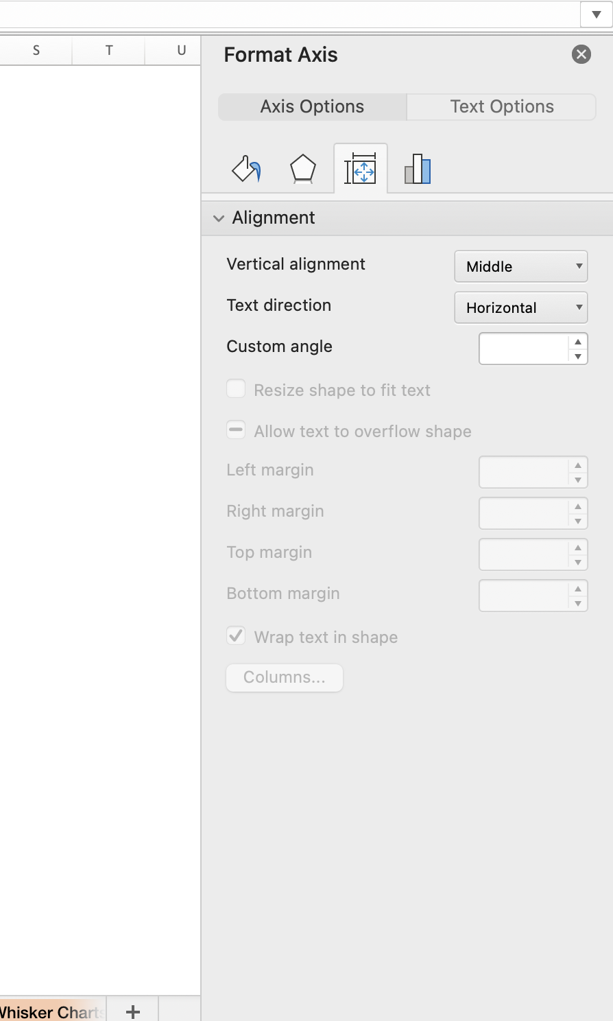
🪄 Format Pane Highlights (Right-Side Panel):
When You Click On the Axis
Dynamic panel that updates based on what you select.
Gives you fine-grained control over formatting.
Includes effects, fill, line, size, alignment, and more.
Super useful for polishing and personalizing your charts.

Slide 16
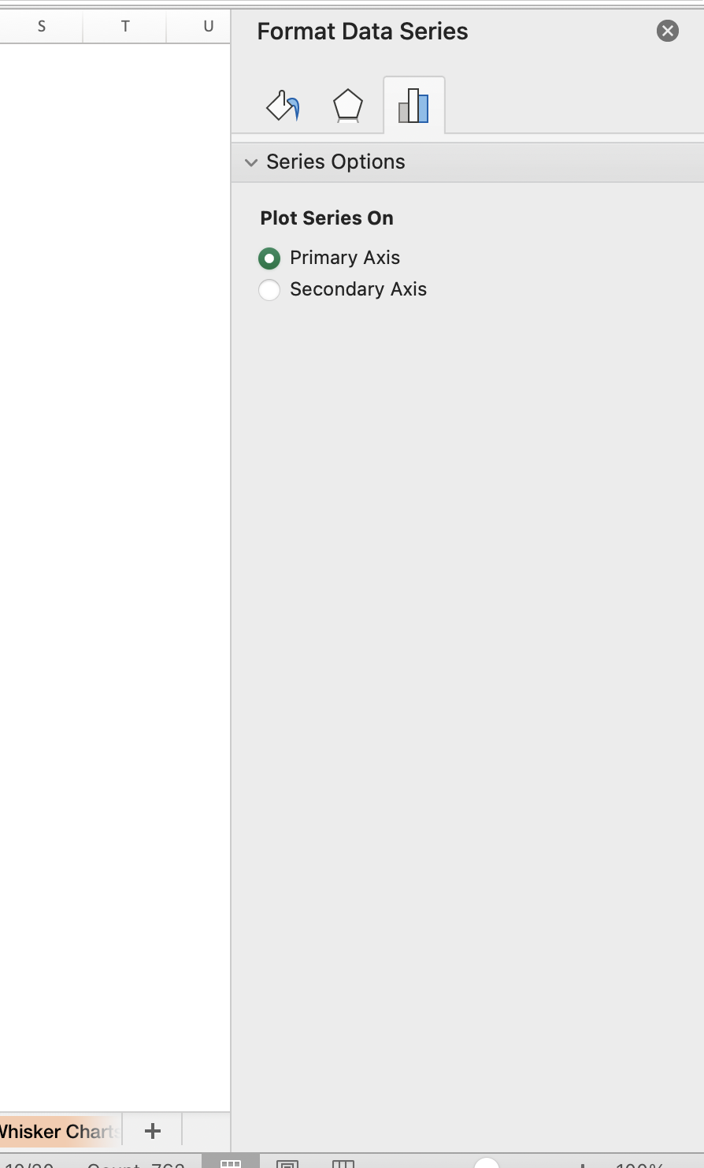
🪄 Format Pane Highlights (Right-Side Panel):
When You Click On the Data Points
Dynamic panel that updates based on what you select.
Gives you fine-grained control over formatting.
Includes effects, fill, line, size, alignment, and more.
Super useful for polishing and personalizing your charts.

Slide 17
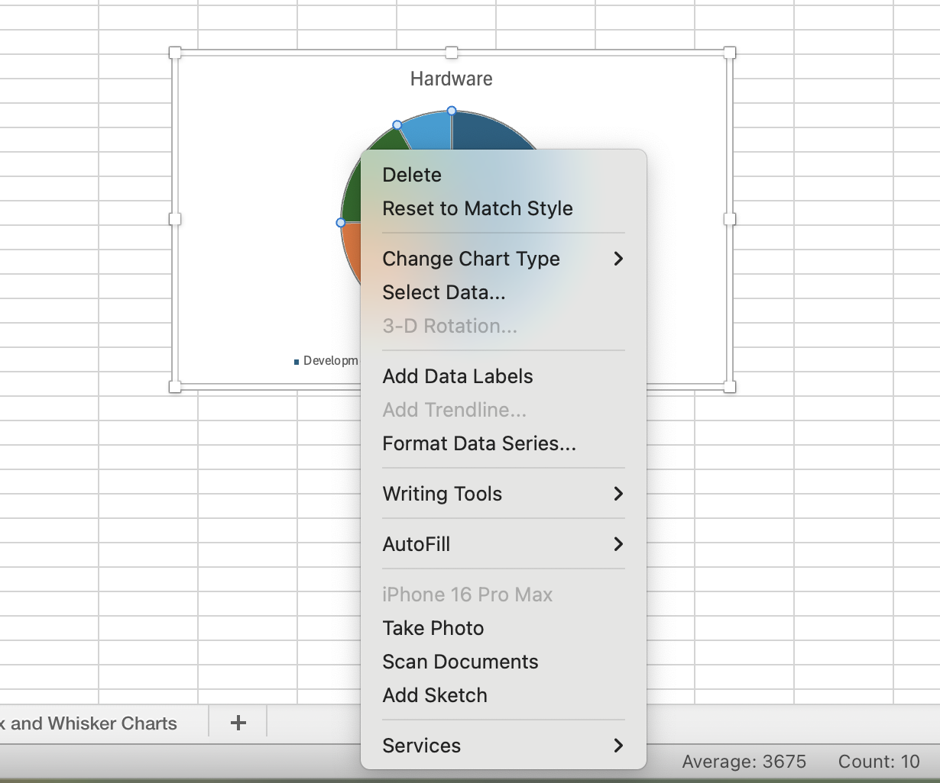
Pro Tip
Right-clicking also gives a shortcut menu with direct options like "Format Data Series", "Add Data Labels", or "Change Chart Type”.

Slide 18
Bar & Column Charts
Bar & Column Charts
Used for: Comparing numerical data across categories.
Examples:
Total sales by product type
Revenue by department, by quarter
Pro Tips:
Use stacked or clustered bars/columns for subgroup comparisons.
Apply custom formatting to color-code values.

Slide 19
Viewers by Genre Bar Chart
Sheet name on the Excel file: Bar & Column Charts
Start by inserting a 2D Bar Chart from the Insert tab.
Excel may leave the visualization blank initially. That’s fine!
Right-click on the blank chart and select "Select Data."
Click ”+ "
Series Name: "Sales by Genre"
Values: Select the total sales data (e.g., N3 through N6).
Under the axis labels Select Genre names (A3 through A6) and press OK.
Press Ok to populate the values
Final Formatting:
Adjust the X-axis text size for readability.
Make labels bold and increase size.
Reduce Gap Width in Format Data Series for a better look.

Slide 20
This bar chart clearly shows that: Drama drive the most sales, followed by Action, then Rom-Com, and finally Documentary.

Slide 21
Practice: Viewers by Month
Sheet name on the Excel file: Bar & Column Charts
Start by inserting a 2D Column Chart from the Insert tab.
Excel may leave the visualization blank initially. That’s fine!
Right-click on the blank chart and select "Select Data."
Click ”+ "
Series Name: "Sales by Month"
Values: Select the total sales data by month (B7 through M7).
Under the axis labels Select Months (B3 through M6) and press OK.
Press Ok to populate the values

Slide 22
This bar chart shows that: Number of Viewers increases in during Summer.

Slide 23
Practice: Advanced Visualization, Viewers by Genre and Month
Sheet name on the Excel file: Bar & Column Charts
Start by selecting the entire table from A2 to M6. Don’t select the total row and column
Select “insert” and choose a 2D Column Chart and the data will populate in the chat
Click on the Chart Title to adjust it to Viewers by Genre and Month
You can now select Char Design and choose any design you prefer

Slide 24
Ensure that the X-axis represents the months (Jan to Dec), and the bars are color-coded by Show Genre (Drama, Action, Documentary, Rom-Com). If the chart appears reversed, go to the Select Data Source window and click "Switch Row/Column". This will correctly assign months to the X-axis and genres to the legend. Click OK, and your chart will now display as intended: X-axis = Months, with grouped bars representing each genre.

Slide 25
Line Charts
Used for: Visualizing trends over time.
Examples:
Stock price movements
Profit growth by quarter
Pro Tips:
Use trendlines to identify patterns.
Combine line & column charts to compare different scales.

Slide 26
Practice: Stock Price Movements With Trend Line
Sheet name on the Excel file: Line Charts
Select the data ( column A for dates, column B and C for values).
Go to the Insert tab and select Line Chart.
Adjust the chart title and the axis tick size as needed.
Choose from 2D Line, Stacked Line, Or Line with Markers
Right Click on the line chart to select it.
Right Click on the line chart to select it. Go to Add Trend Line
Select Trend Line from:
Linear
Polynomial
Logarithmic
Notes:
Go to the Insert tab and select Line Chart.

Slide 27
Line Chart Example

Slide 28
Area Charts
Used for: Showing changes in data composition over time.
Examples:
Sales by department, by month
Percentage of downloads by browser
Pro Tips:
Keep unique categories below six for clarity.
Use custom formatting for dynamic highlights.

Slide 29
Practice: 2023 Renewable Energy Production (in MWh)
Sheet name on the Excel file: Area Charts
Select the entire data (A2:M6)
Go to the Insert tab and select Line Chart.
Adjust the chart title and the axis tick size as needed.
Select 2D Area Chart
Notes:
Go to the Insert tab and select Line Chart.

Slide 30
Area Chart Example

Slide 31
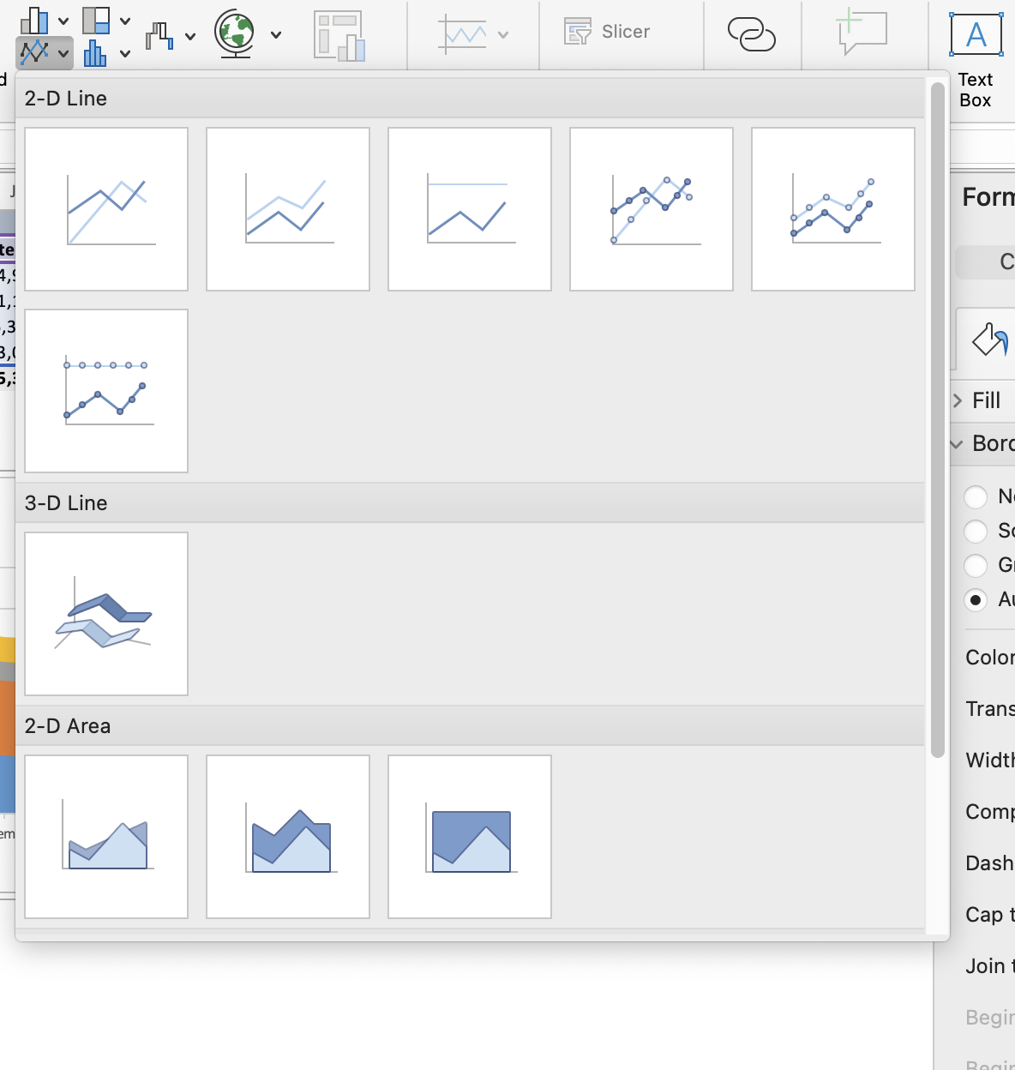
Using 100% Stacked Area Charts
Copy the stacked area chart.
Change chart type to 100% Stacked Area Chart.
The Y-axis rescales to 0–100%, emphasizing proportions rather than raw values.

Slide 32
100% Stacked Area Charts Example

Slide 33
Next Lecture
Next Lecture we focus on: Pie & Donut Charts, Scatter & Bubble Charts, Bubble Charts, Box & Whisker Charts, Tree Maps & Sunburst Charts

